Slide 1

Department of Human Resources
Annual Report Highlights
(October 1, 2008 – September 30, 2009)
Presented January 14, 2010

Slide 2
Focus
Strategic Plan – Goal Three
Recruit, retain and develop a diverse cadre of the highest quality teaching personnel, staff, and administrators.

Slide 3
Presentation Agenda
New Hires
Minority Staffing
Retirements
Retention – Turnover

Slide 4
New Hires
 | 2005 | 2006 | 2007 | 2008 | 2009
Teachers | 147 | 150 | 146 | 114 | 111*
Administrators (Principals) | 2 | 1 | 2 | 0 | 2
Administrators (Assistant & Associate Principals) | 2 | 1 | 3 | 3 | 1
Administrators (Support & Instructional) | 3 | 4 | 2 | 1 | 2
Classified | 87 | 123 | 110 | 92 | 172
Total | 241 | 279 | 263 | 210 | 288
*These are new hires for the 2009-2010 school year -- includes PT/FT.

Slide 5
New Hires
ELEMENTARY TEACHERS
SECONDARY TEACHERS
Kindergarten – 6
1st Grade – 3
2nd Grade – 3
3rd Grade – 8
4th Grade – 3
5th Grade – 3
SPED – 6
Other - 24
English/Lang. Arts – 8
Math – 7
World Languages – 2
SPED – 13
Science - 4
Social Studies – 6
Other - 12
There were also three teachers hired in Central Office

Slide 6
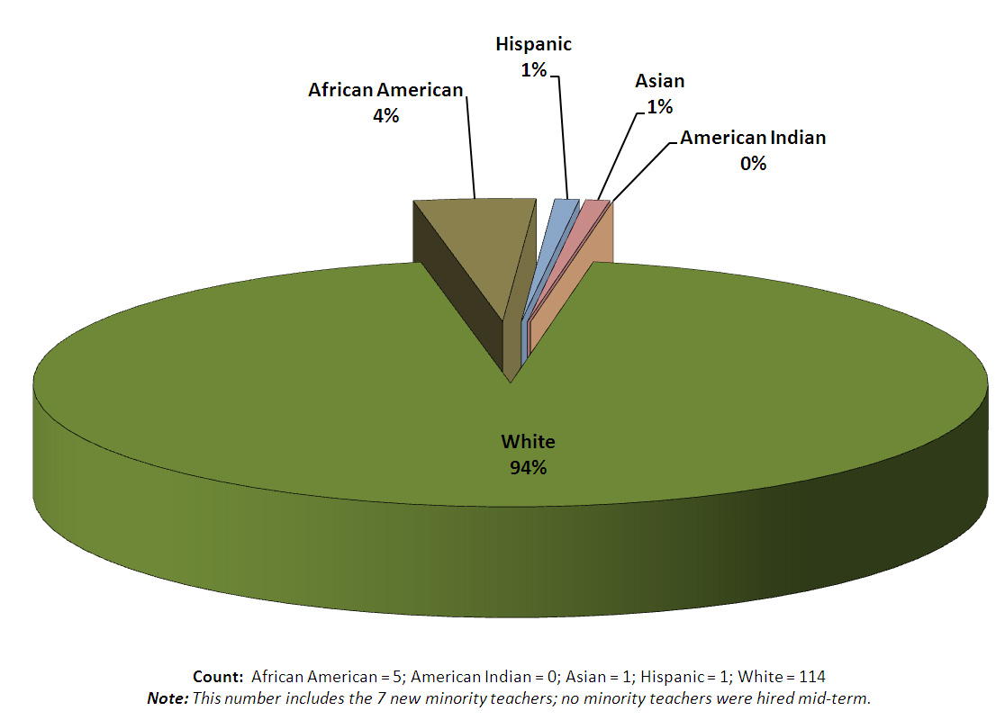
Minority Staffing
NEWLY EMPLOYED TEACHING STAFF SINCE
LAST YEAR’S REPORT

Slide 7
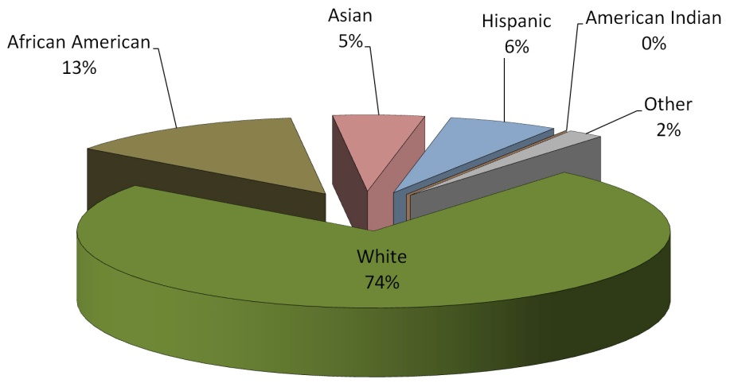
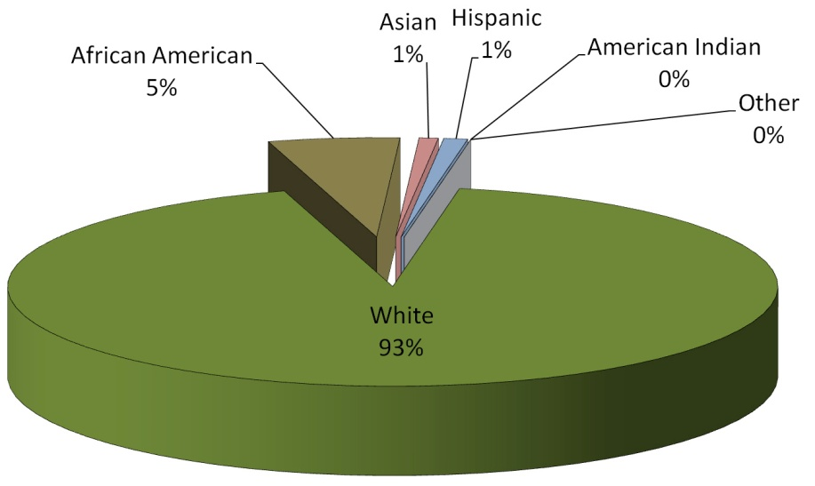
Minority Staffing
Student Ethnic Distribution
Count: 12,742
African American – 1,662
American Indian – 22
Asian – 650
Hispanic – 777
Other – 217
White – 9,414
Total Teaching Staff
Count: 1,174
African American – 64
American Indian – 1
Asian – 12
Hispanic – 14
White – 1,083

Slide 8
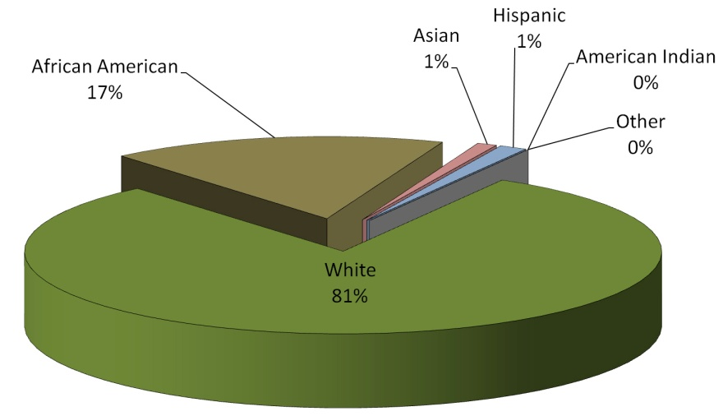
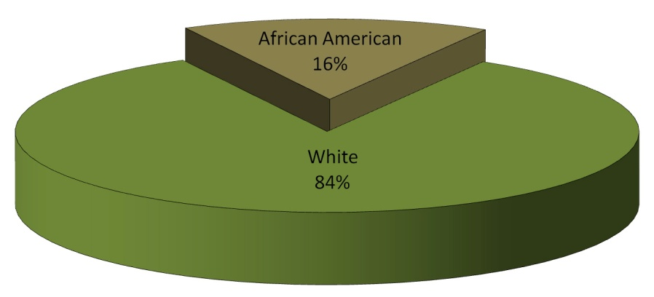
Minority Staffing
Total Classified Employees
Count:
African American – 194
American Indian – 2
Asian – 11
Hispanic – 15
White – 886
Principals and Assistant Principals
Count: 51
African American – 8
American Indian – 0
Asian – 0
Hispanic – 0
White – 43

Slide 9
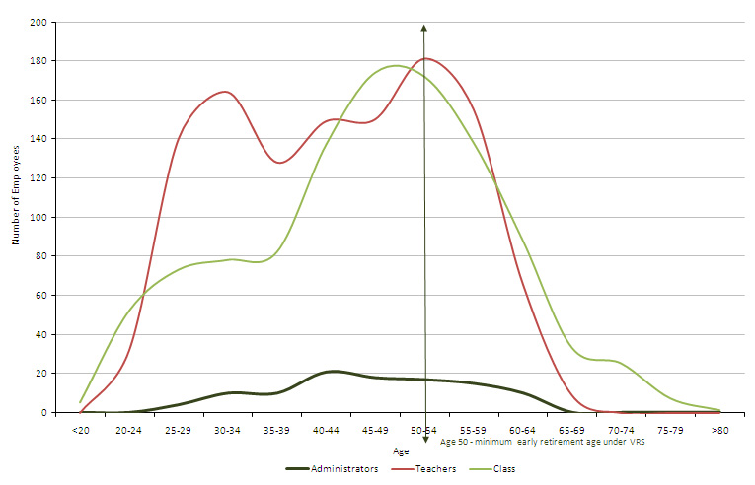
The System’s Aging Workforce
AGE DISTRIBUTION OF ALL EMPLOYEES
2009-2010 School Year
(As of September 30, 2009)

Slide 10
Teacher Retirements

Slide 11
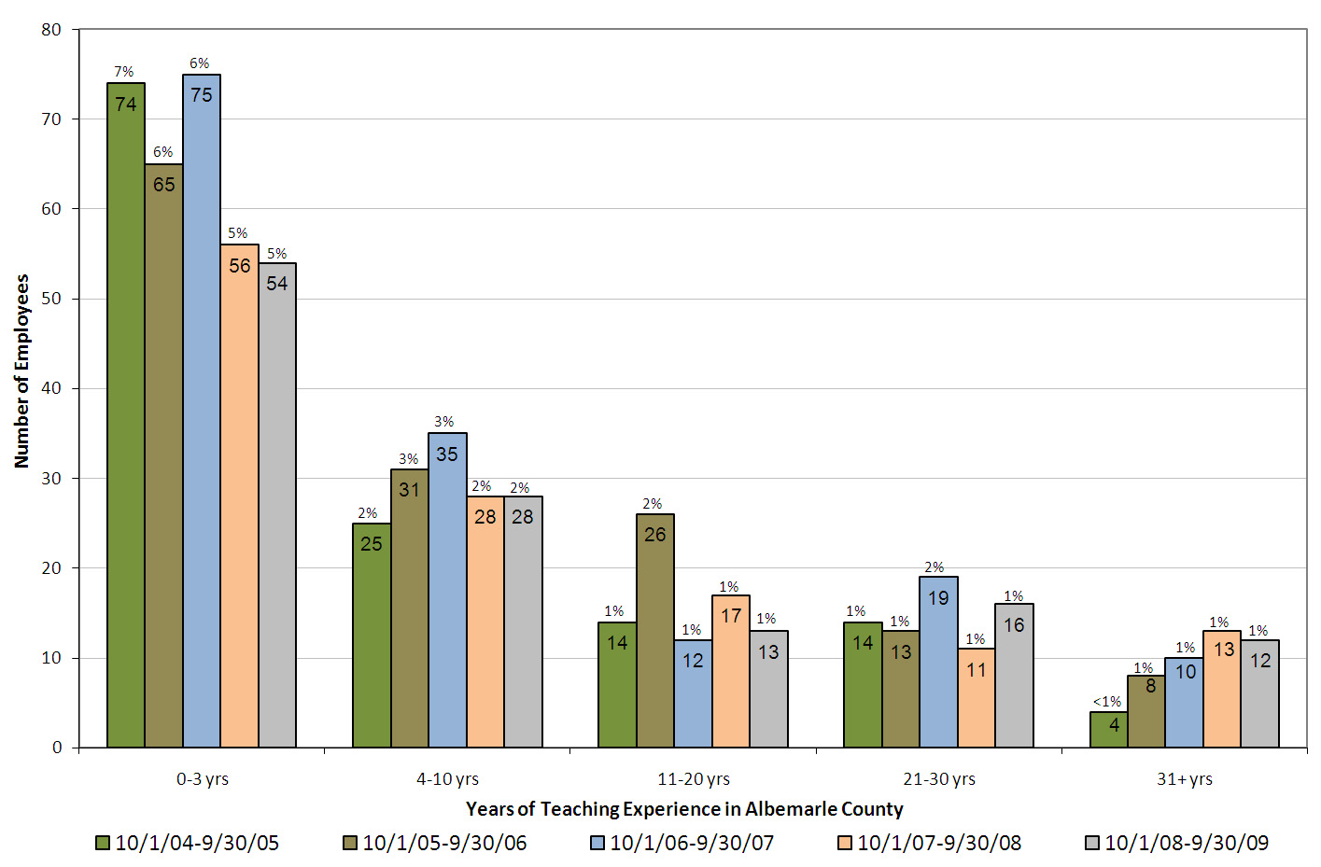
Retention
Of the 123 teachers that left employment over the past year, 41 retired.

